Slide 1
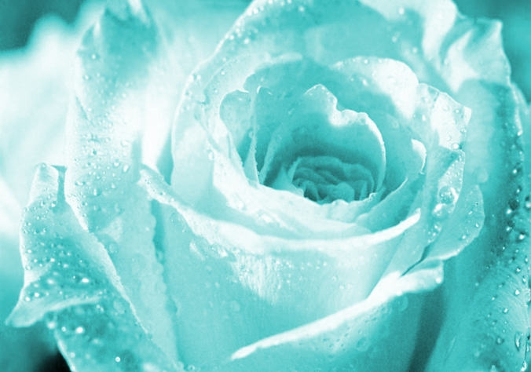
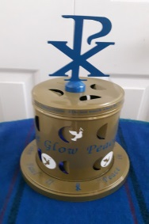
The Circles of Rosary
Opening Prayer
Family
School
Church
In the name of the Father, of the Son, and of the Holy Spirit.
Bless us, O Lord, Jesus Christ, Mother Mary,
St. John Paul II, and St. Teresa of Calcutta, our peace models,
that today in our class we may willingly strive
To give and receive peace
To keep a happy and rewarding teaching class
To show the love of God in all our thoughts and actions every day.
Amen
All Copyrights reserved

Slide 2
The Apostles’ Creed
He ascended into heaven and is seated at the right hand of God the Father Almighty.
From there, He will come again to judge the living and the dead.
I believe in the Holy Spirit, the holy Catholic Church, the communion of saints, the forgiveness of sins, the resurrection of the body, and life everlasting.
Amen.
I believe in God, The Father Almighty, creator of heaven and earth,
And in Jesus Christ, his only Son, our Lord,
Who was conceived by the Holy Spirit,
born of the Virgin Mary,
Suffered under Pontius Pilate,
was crucified, died, and was buried.
He descended into hell;
on the third day,
He rose again from the dead;

Slide 3
Our Father
Our Father, who art in Heaven,
Hallowed be thy name.
Thy kingdom come, thy will be done,
on earth as it is in Heaven.
Give us this day our daily bread,
and forgive us our trespasses,
As we forgive those who trespass against us
And lead us not into temptation
But deliver us from evil.
Amen.

Slide 4
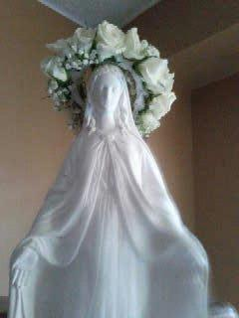
Hail Mary
Hail Mary, full of grace!
The Lord is with thee.
Blessed are thou amongst women,
And blessed is the fruit of thy womb, Jesus.
Holy Mary, Mother of God,
Pray for us sinners
Now and until the hour of death.
Amen.

Slide 5
Glory Be
Glory be to the Father,
And to the Son,
And to the Holy Spirit
As it was in the beginning,
Is now, and ever shall be
World without end.
Amen.

Slide 6
Fatima Prayer
O my Jesus,
Forgive us our sins,
Save us from the fires of hell,
Lead all souls to Heaven,
Especially those who need most of thy mercy.

Slide 7
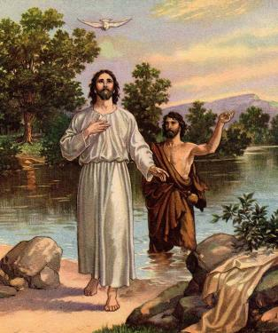
The First Luminous Mystery
Jesus is Baptized by John in the River Jordan
Obtain for us, dearest Mother, from your Divine Son, the grace and power of the Holy Spirit
to be the light of the world and salt of the earth as Jesus wants us to be.
Intentions _________________

Slide 8
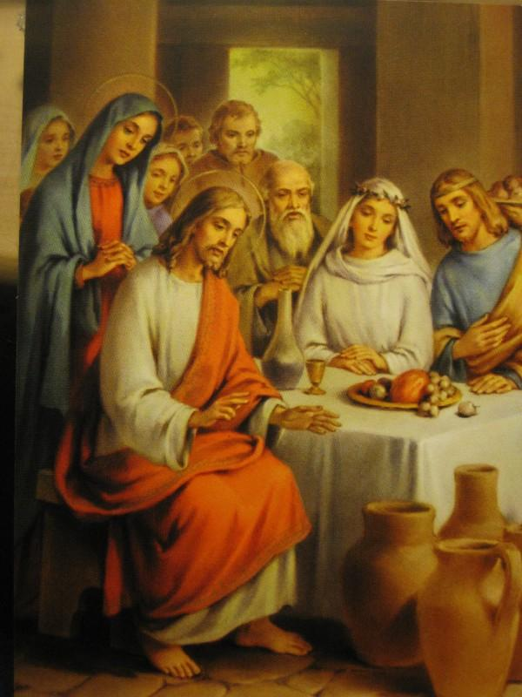
The Second Luminous Mystery
Jesus works his first miracle at the Wedding at Cana
Obtain for us, dearest Mother, from your Divine Son, the grace and power of the Holy Spirit
to do whatever Jesus tells us and to go about doing good as Jesus did.
Intentions ___________________

Slide 9
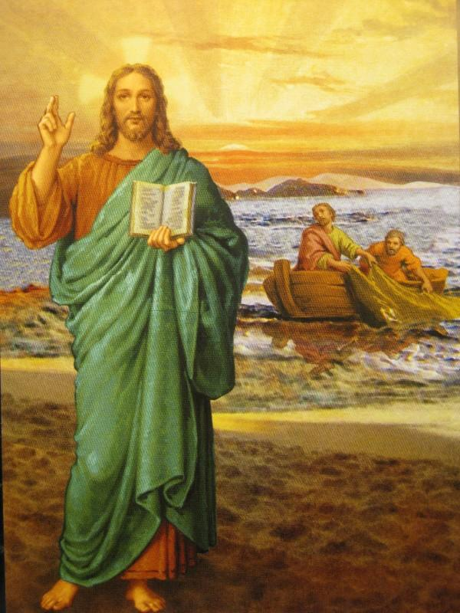
The Third Luminous Mystery
Jesus Proclaims the Kingdom and calls for conversion
Obtain for us, dearest Mother, from your Divine Son, the grace and power of the Holy Spirit
to belong to God’s kingdom through a change of heart. Help us proclaim it by living in Christ’s ways and become witnesses of Christ.
Intentions _____________________

Slide 10
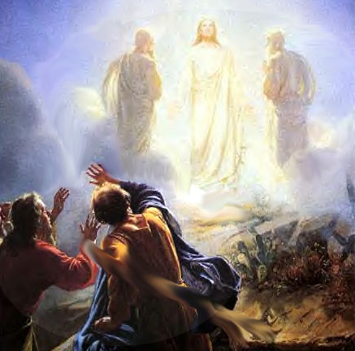
The Fourth Luminous Mystery
Jesus is Transfigured on
Mt. Tabor
Obtain for us, dearest Mother, from your Divine Son, the grace and power of the Holy Spirit
to transform us into the likeness of Christ.
Intentions ___________________

Slide 11
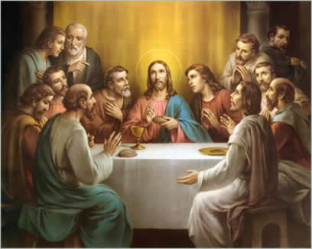
The Fifth Luminous Mystery
Jesus institutes the Holy Eucharist
Obtain for us, dearest Mother from your Divine Son, the grace and power of the Holy Spirit
to appreciate Christ’s gifts and to put them to good use in serving God.
Intentions _________________

Slide 12
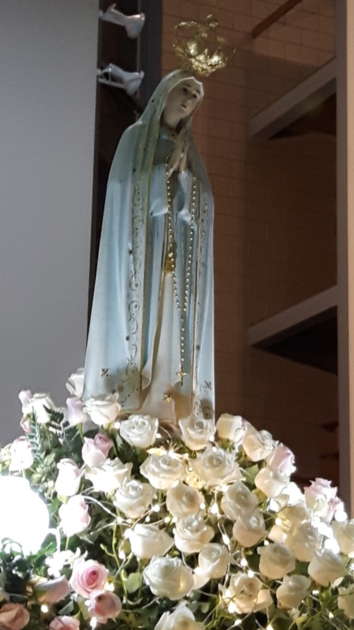
Hail Holy Queen
Hail Holy Queen, Mother of Mercy,
Hail our life, our sweetness and our hope,
to thee do we cry, poor banished children of Eve;
to thee do we send up our sighs, mourning,
and weeping in this valley of tears.
Turn then, most gracious Advocate, thine eyes of mercy toward us,
and after this our exile,
show unto us the blessed fruit of thy womb, Jesus.
O Clement, O loving, O sweet Virgin Mary
Leader: Pray for us, O holy Mother of God
Response: That we may be made worthy of the promises of Christ. Amen

Slide 13
Act of Consecration
O God, whose only begotten Son,
by His life, death, and resurrection,
has purchased for us the rewards of eternal salvation.
Grant we beseech Thee
that while meditating on these mysteries
of the most Holy Rosary of the Blessed Virgin Mary,
that we may both imitate what they contain,
and obtain what they promise,
through Christ our Lord. Amen.

Slide 14
The Circles of Rosary
Closing Prayer
School
Family
Church
Thank you, Lord, for holding us in the palms of your hands.
Thank you for blessing our teachers
who teach us to be the best in our school works
and
who help us to live and grow with our faith.
Peace and love around the world starts with you and me.
Help us to be peacemakers in the name of God.
Amen.
Copyrights reserved

Slide 15

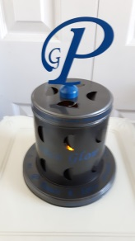
Let there be peace on earth
and let it begin with me
Let there be peace on earth,
the peace that was meant to be
With God as our Father,
children all are we
Let us walk with each other
in perfect harmony
Let peace begin with me,
let this be the moment now
With every step I take,
Let this be my solemn vow
To take each moment
and live each moment
in peace eternally
Let there be peace on earth
and let it begin with me
- Jill Jackson & Sy Miller-

